Slide 1
Amazon ElastiCache: increasing performance and lowering
Presented by: Chinwuba chidubem

Slide 2
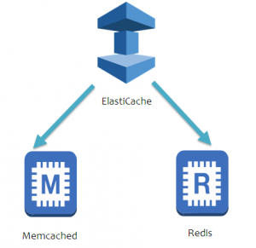
ARCHITECTURE

Slide 3
OUTLINE
INTRODUCTION
CREATE REDIS CLUSTER
CREATE SUBNETS
LAUNCH REDIS CLUSTER

Slide 4
INTRODUCTION
Caches are in-memory databases with really high performance, low latency.
Helps reduce load off of databases for read intensive workloads
Helps make your application stateless
AWS takes care of OS maintenance / patching, optimizations, setup, configuration, monitoring, failure recovery and backups
Using ElastiCache involves heavy application code changes

Slide 5
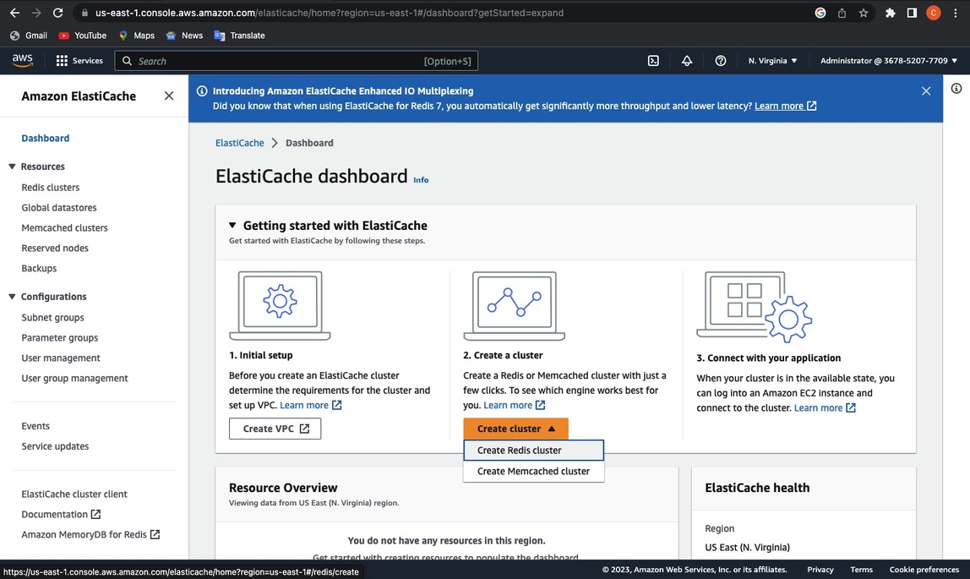
CREATE REDIS CLUSTER

Slide 6
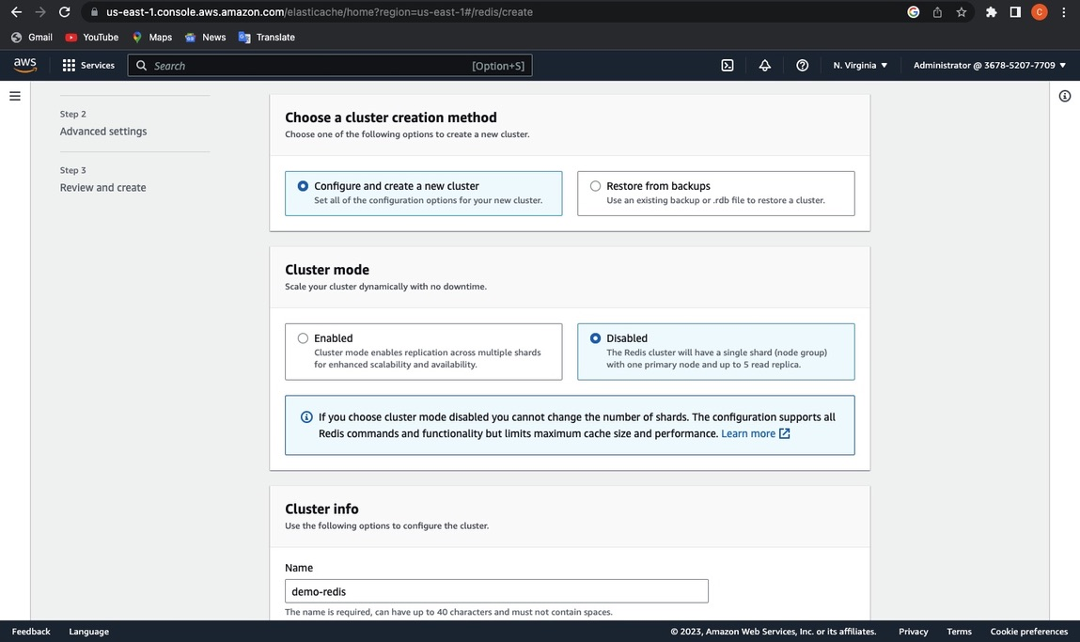

Slide 7
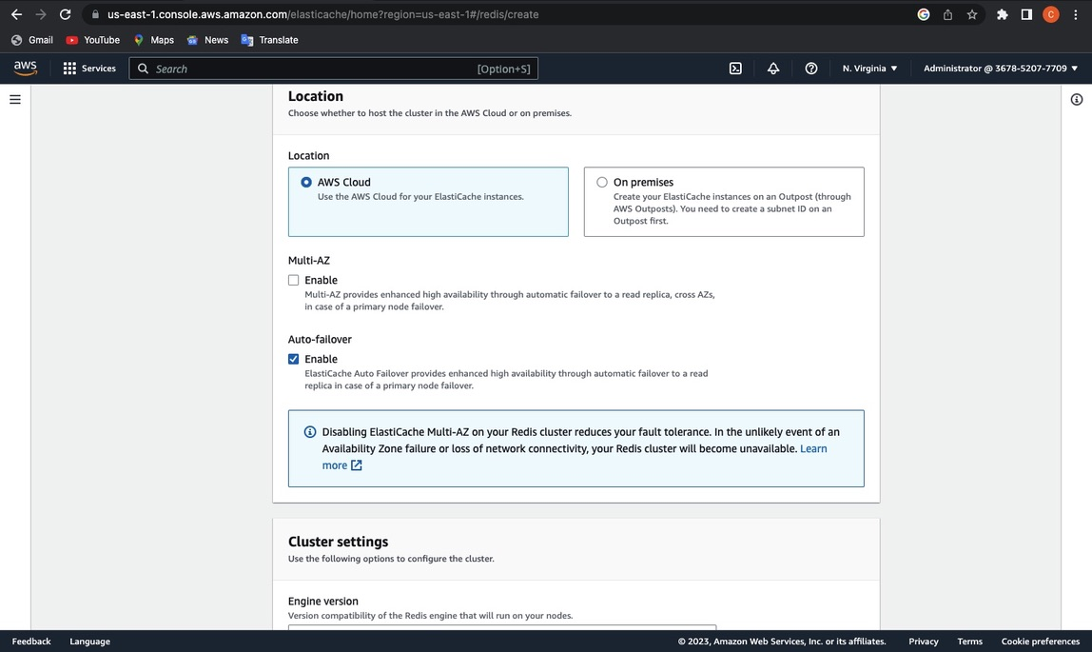

Slide 8
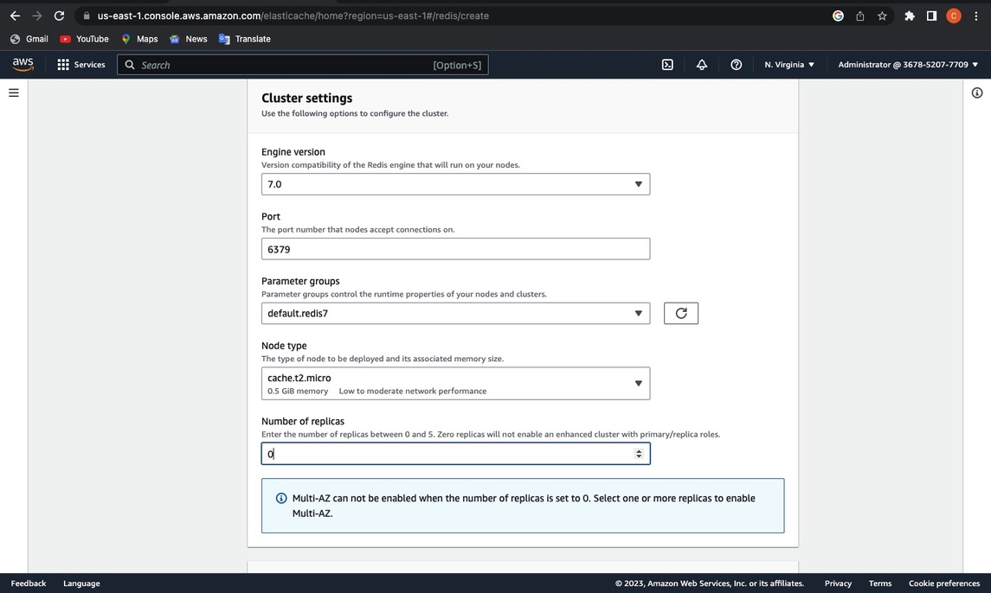

Slide 9
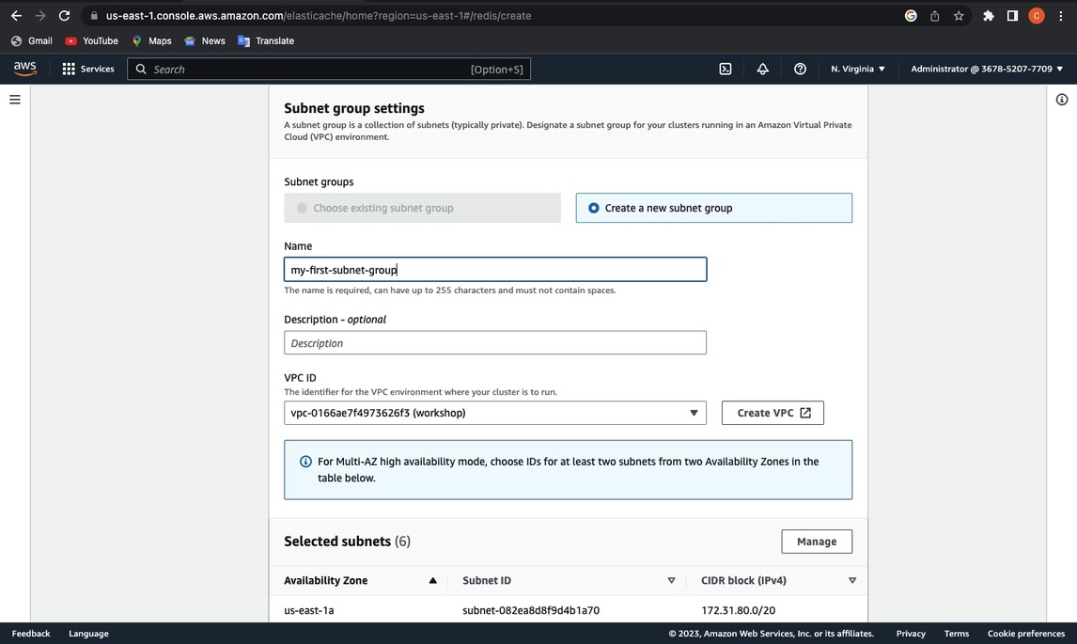
CREATE SUBNETS

Slide 10
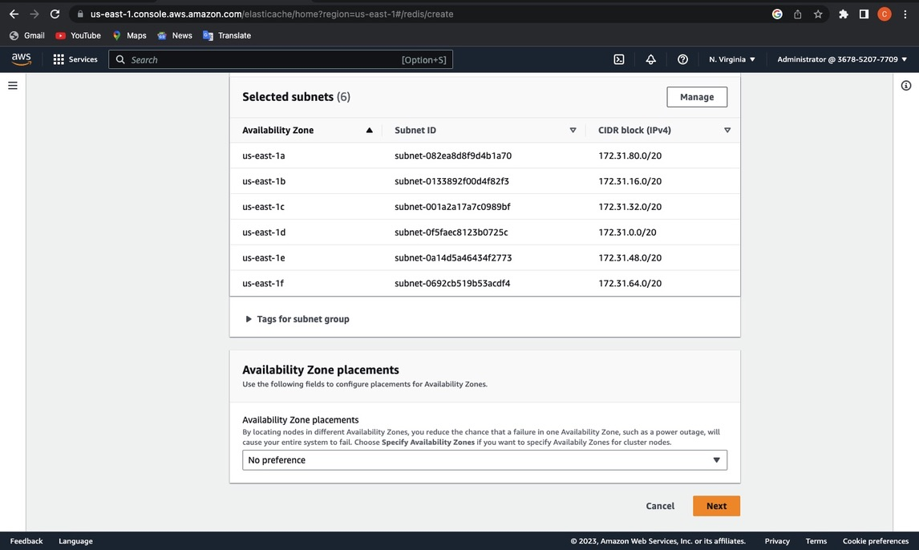

Slide 11
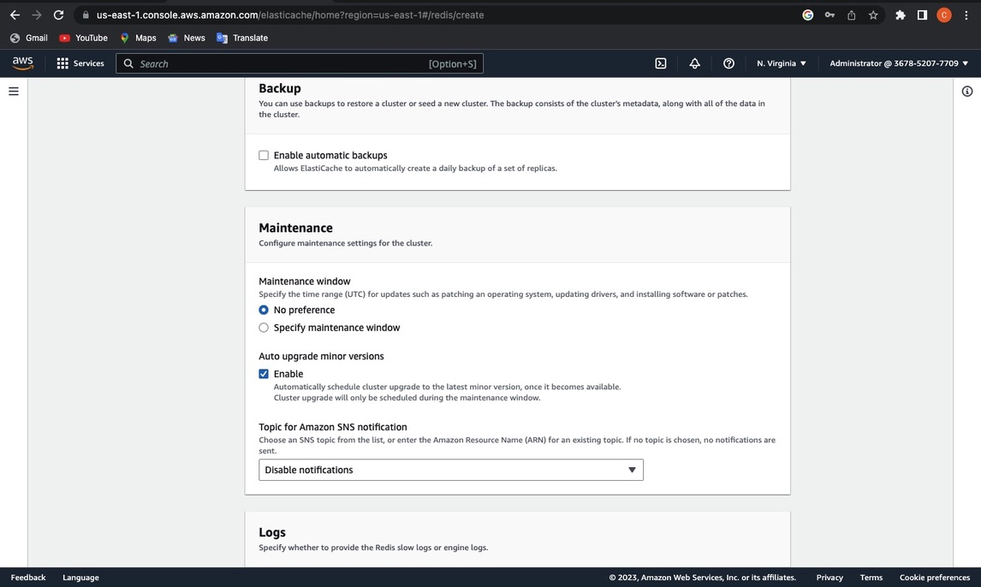

Slide 12
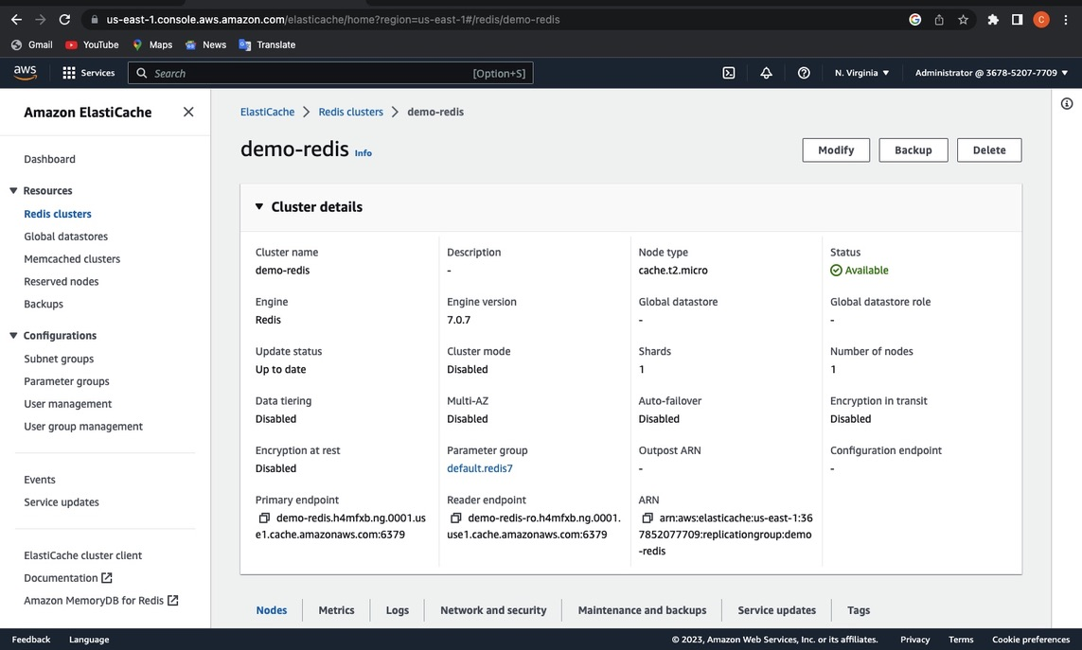

Slide 13
